Slide 1
Measuring the Fraction of CO₂ in Air with Fourier Transform Infrared Spectroscopy
Esther Lin | ENPH 352

Slide 2
Objectives
To measure the fraction of CO₂ in air
To measure and understand the absorption spectra of N₂, CO₂ and air (aggregation of atmospheric gases)

Slide 3
Theory
In the mid-infrared region of the electromagnetic spectrum, molecules absorb light through the interaction between the photons and the vibrating electric dipoles of the molecule.
In FTIR, a beam carrying many frequencies irradiates a sample. We measure how much of that beam is absorbed and transmitted by the sample.
With the transmission and absorbance spectra, we can identify the molecules in the sample.
Vibrational modes of molecules
http://brussels-scientific.com/?p=5975

Slide 4
General Setup
The FTIR is based on the Michelson interferometer. A multimode laser transmits light on the beamsplitter, which splits the light into two beams. The first beam hits the stationary mirror and transmits to the detector through the gas cell. The second beam travels to the scanning mirror. By translating the scanning mirror, different wavelengths in the beam are selected to pass through the gas cell. The detector records the interaction of the beams with the molecules (interferogram) in the gas cell and sends the information to a computer for Fourier Transform analysis.
Notes:
Big paragraph. List components bullet points.

Slide 5
Method: Data Collection
Interferogram captured with no gas cell, and the FTIR flushed with N₂. We proceed to capture interferograms where the gas cell is in place, flushed with N₂, CO₂, and air, all with FTIR flushed with N₂.
Notes:
Caption interferogram. Take out fluff. Do caption style.

Slide 6
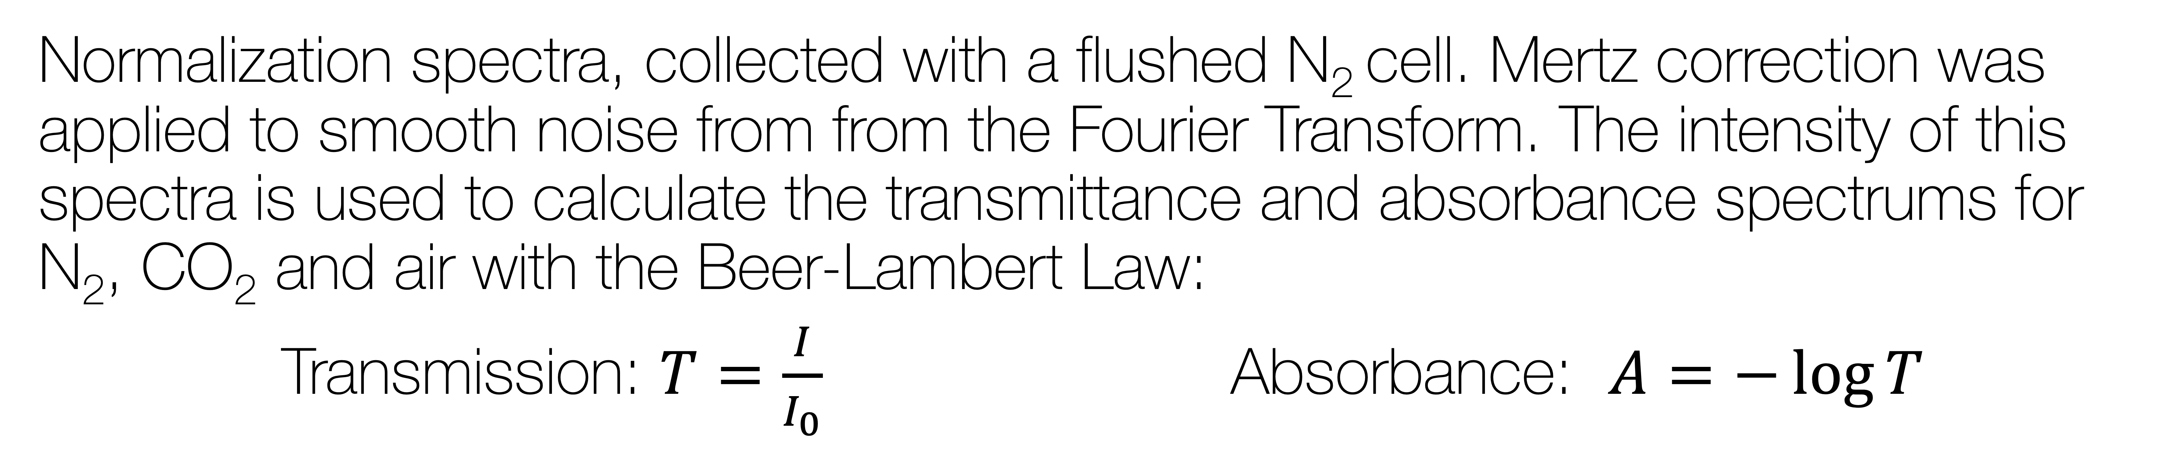
Method: Data Analysis
Normalization spectra, collected with a flushed N₂ cell. Mertz correction was applied to smooth noise from from the Fourier Transform. The intensity of this spectra is used to calculate the transmittance and absorbance spectrums for N₂, CO₂ and air with the Beer-Lambert Law:
Transmission: $T=\frac{I}{I_{0}}$Absorbance: $A=−\log{T}$
Notes:
Less procedural, more general.

Slide 7
Method: Mertz Correction
Comparison of spectra with and without Mertz correction. The Mertz correction method modulates the spectra with a triangular signal, to smooth out ringing with taking the Fourier transform of the interferogram. The spectrum with the Mertz correction is smoother and less noisy.

Slide 8
Results: Spectrums of CO₂
(a)
H₂O
CO₂
(b)
(a) Transmission spectra of CO₂. (b) Absorption spectra of CO₂. We see a strong peak around 2350 cm⁻¹, which is where CO₂ absorbs. Hence, the FTIR has identified the CO₂ in our gas cell of CO₂.

Slide 9
Results: Spectrums of Air
(a)
H₂O
CO₂
(b)
(a) Transmission spectra of air. (b) Absorption spectra of air. We see a weak peak around 2350 cm⁻¹, which is where CO₂ absorbs. Hence, the FTIR has identified the CO₂ in our gas cell of air.

Slide 10
Results: Spectrums of N₂ (control)
(a)
H₂O
CO₂
(b)
(a) Transmission spectra of N₂. (b) Absorption spectra of N₂. We that N₂ does not absorb at 2350 cm⁻¹. This spectrum is very similar to that of air, since air is ~ 75% N₂.

Slide 11
Results: Summary
Molecule | Measured Wavenumber [cm⁻¹] | Expected Wavenumber [cm⁻¹]
CO₂ | 2352 ± 22 | 2362
Molecule | Measured Fraction [%] | Expected Fraction [%]
CO₂ in air | 8 ± 1 | 0.04

Slide 12
Conclusions
FTIR is a useful tool for the identification of molecules in gas samples
Lineshape characteristics (width, tail) in FTIR spectrums can be used to infer the type of molecular movements and interactions in the sample
Measurements of gas cells are limited by the thoroughness of flushing

